Slide 1
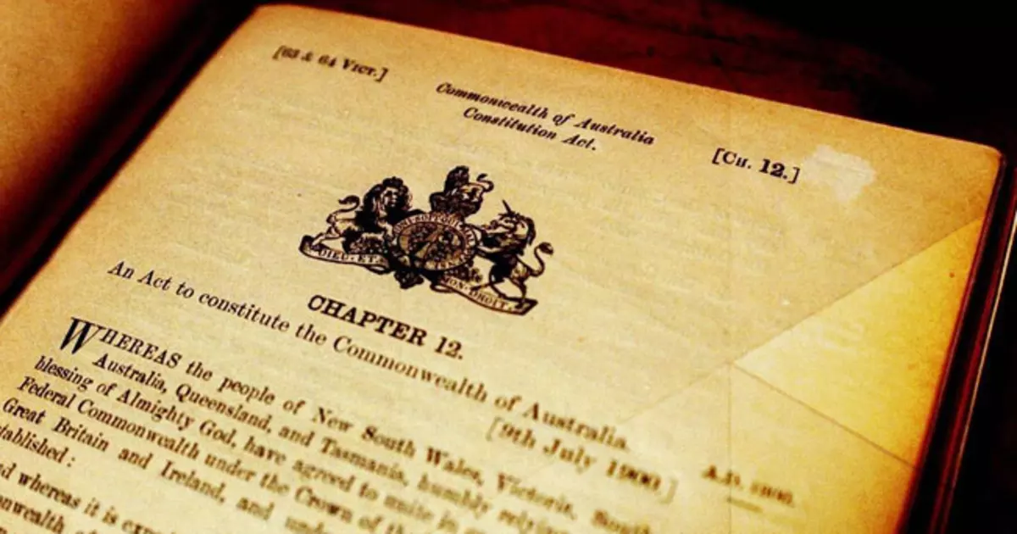
Constitution Quiz

Slide 2
1. The Constitution is:
The set of rules by which Australia is run
b) A list of laws in Australia
c) The Declaration of Independence

Slide 3
2. On which date did the Australian Constitution come into effect?
a) January 1, 1901
b) January 26, 1788
c) May 9, 1988

Slide 4
3. Which of these powers is outlined in the Constitution?
a) The powers of the Prime Minister
b) The powers of the federal police
c) The powers of the Parliament, the executive and the judiciary (courts)

Slide 5
4. Which of the following is a right guaranteed in the Australian Constitution?
a) The right to privacy
b) The right to a trial by jury
c) The right to free speech

Slide 6
5. The Commonwealth of Australia Constitution Act was passed in 1900 by which Parliament?
a) The Australian Parliament
b) The United Nations
c) The British Parliament

Slide 7
6. How do we change the Constitution?
a) By referendum
b) Only the Queen can change it
c) Parliament votes on it

Slide 8
7. A referendum to change the Constitution needs to be agreed to by:
a) A majority of voters across the nation
b) A majority of voters across the nation, and a majority of voters in a majority of states
c) A majority of states

Slide 9
ANSWERS

Slide 10
1. The Constitution is:
The set of rules by which Australia is run
b) A list of laws in Australia
c) The Declaration of Independence

Slide 11
2. On which date did the Australian Constitution come into effect?
a) January 1, 1901
b) January 26, 1788
c) May 9, 1988

Slide 12
3. Which of these powers is outlined in the Constitution?
a) The powers of the Prime Minister
b) The powers of the federal police
c) The powers of the Parliament, the executive and the judiciary (courts)

Slide 13
4. Which of the following is a right guaranteed in the Australian Constitution?
a) The right to privacy
b) The right to a trial by jury
c) The right to free speech

Slide 14
5. The Commonwealth of Australia Constitution Act was passed in 1900 by which Parliament?
a) The Australian Parliament
b) The United Nations
c) The British Parliament

Slide 15
6. How do we change the Constitution?
a) By referendum
b) Only the Queen can change it
c) Parliament votes on it

Slide 16
7. A referendum to change the Constitution needs to be agreed to by:
a) A majority of voters across the nation
b) A majority of voters across the nation, and a majority of voters in a majority of states
c) A majority of states

